Slide 1
Wah Pedal
CJ Tulowiecki & Eric Walden

Slide 2
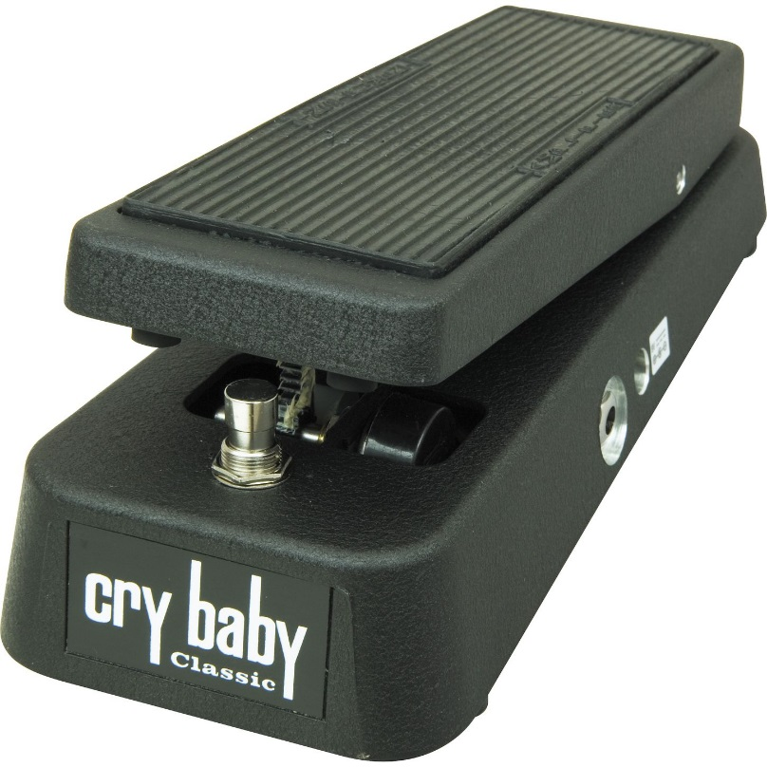
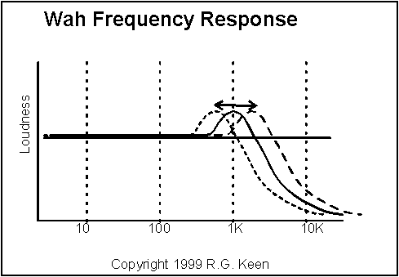
What is a wah pedal?
Electrical guitar effects pedal
Name is an onomatopoeia, “wah-wah”
Mimics the human voice
Moving pedal sweeps the cutoff frequency of a filter applied to input signal

Slide 3
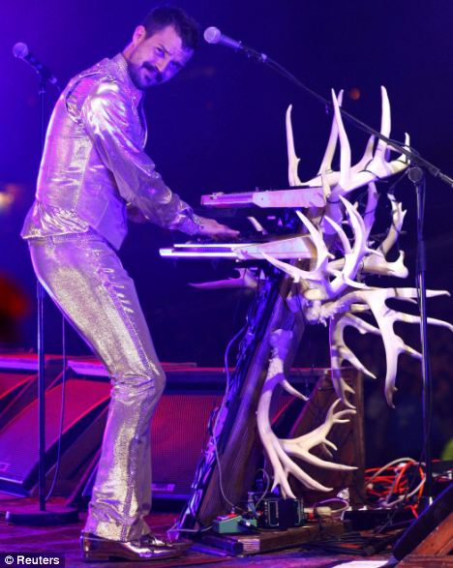
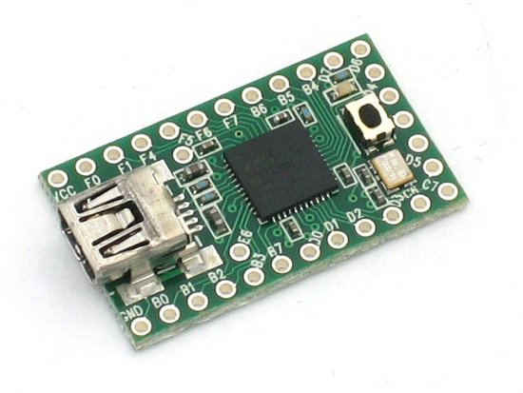

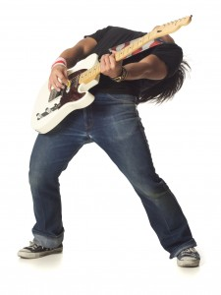

Objectives
Use a microcontroller to make a wah pedal
Control cutoff frequency with the wah pedal’s potentiometer
Learn about digital audio processing
Make interesting sounds

Slide 4
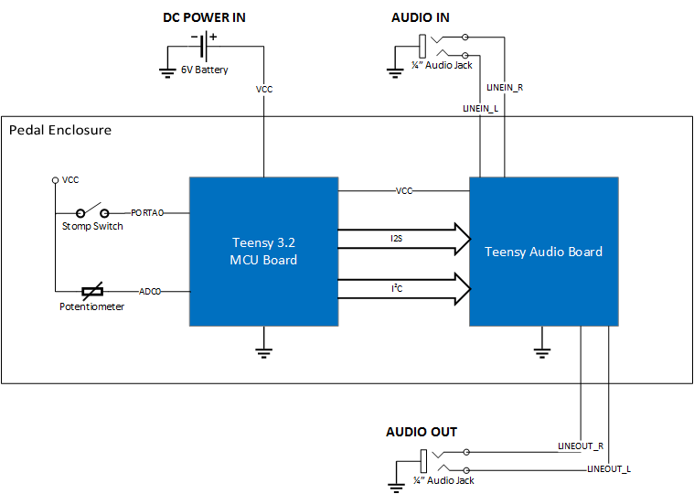
Original Hardware Design

Slide 5

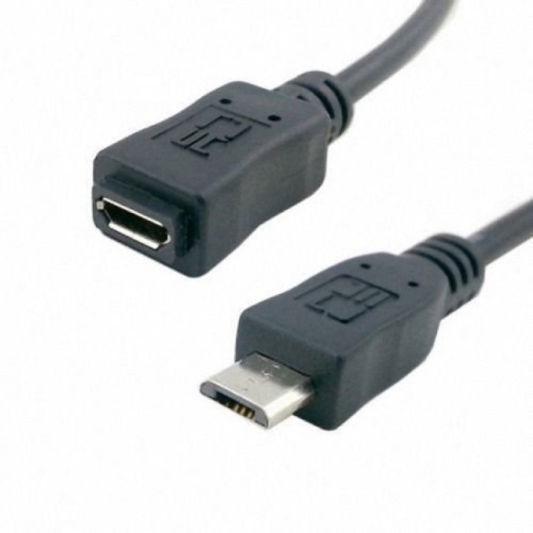
Changes to Hardware
New regulator
Mono inputs and outputs
USB cable

Slide 6
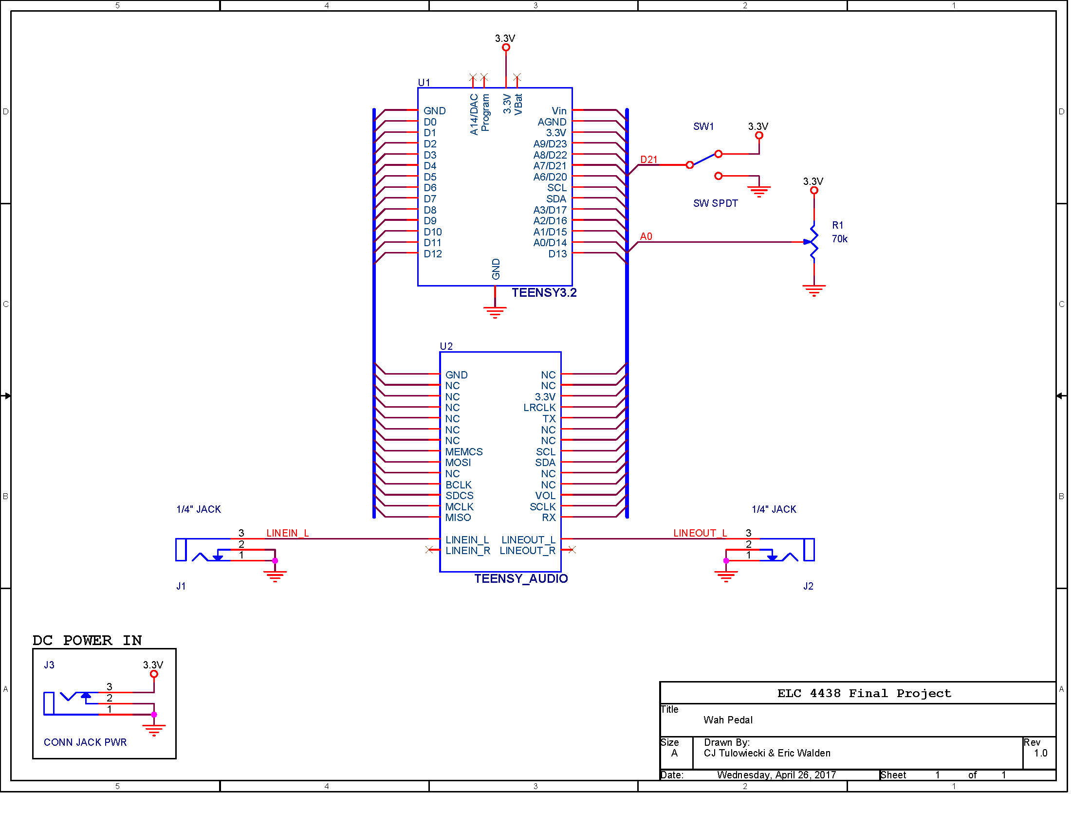
Current Hardware Design

Slide 7
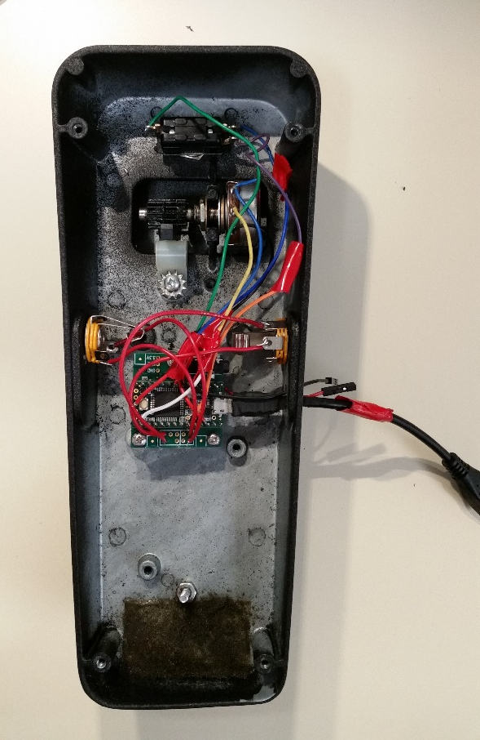
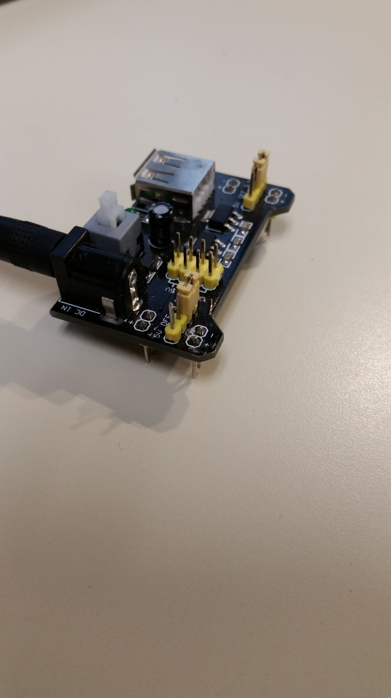
Hardware Implementation
Regulator
Switch
Potentiometer
Jacks
Teensy
Cable

Slide 8
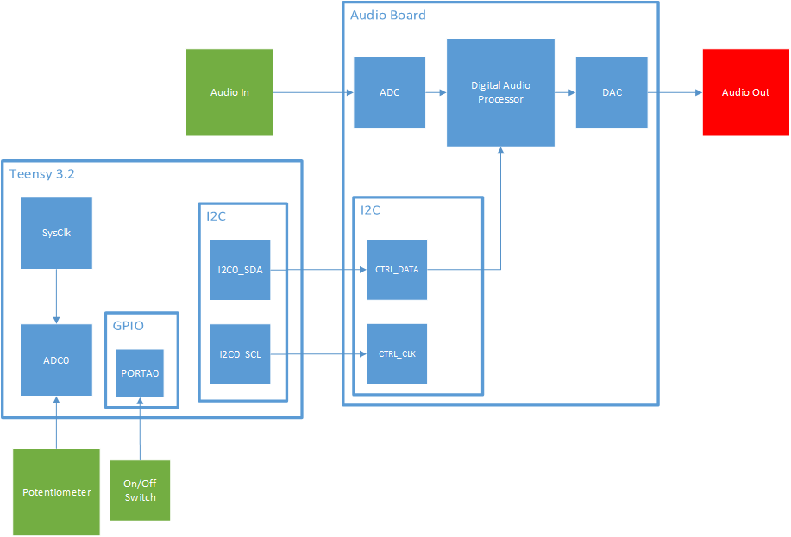
Original Software Design

Slide 9
Changes to Software
Used processor on main Teensy board to process audio
I2S between Teensy and Audio Board
Changed GPIO pin
Modified filter resonance and frequency sweep range to provide desired sound

Slide 10
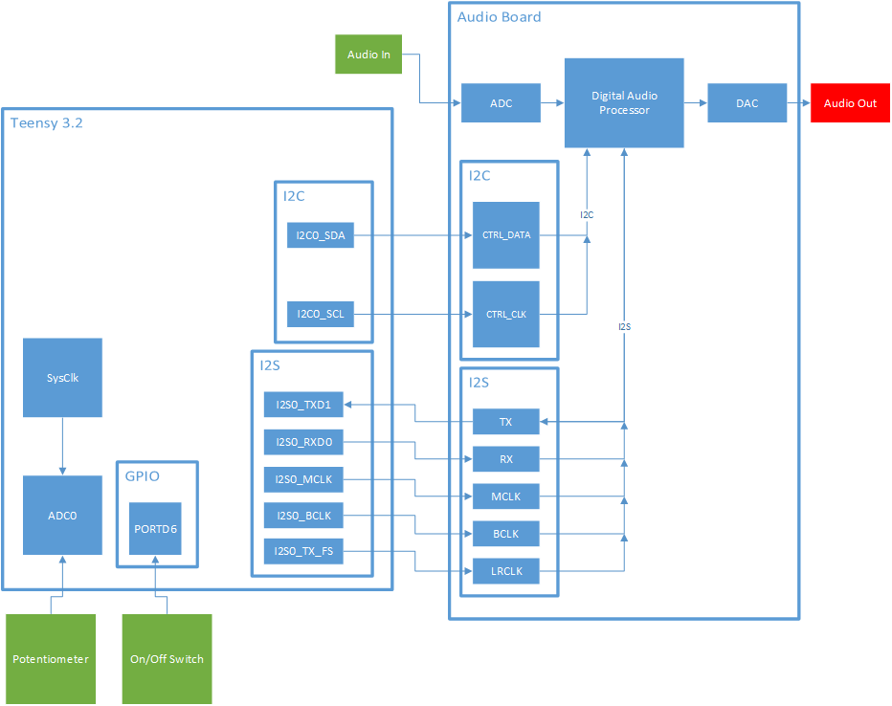
Current Software Design

Slide 11
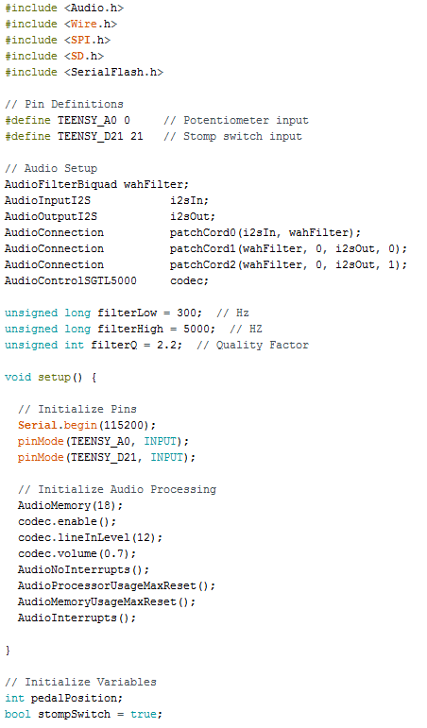
Software Implementation

Slide 12
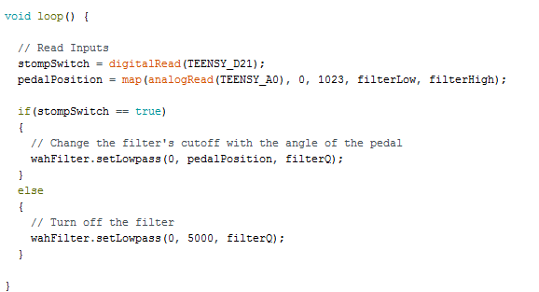
Software Implementation

Slide 13
Demo

Slide 14
Questions?

